Slide 1

Slide 27- <number>

Slide 2
Chapter 27
XML: Extensible Markup Language
Copyright © 2007 Ramez Elmasri and Shamkant B. Navathe

Slide 3
Chapter Outline
Introduction
Structured, Semi structured, and Unstructured Data.
XML Hierarchical (Tree) Data Model.
XML Documents, DTD, and XML Schema.
XML Documents and Databases.
XML Querying.
  XPath
  XQuery
Slide 27- <number>

Slide 4
Introduction
Although HTML is widely used for formatting and structuring Web documents, it is not suitable for specifying structured data that is extracted from databases.
A new language—namely XML (eXtended Markup Language) has emerged as the standard for structuring and exchanging data over the Web.
  XML can be used to provide more information about the structure and meaning of the data in the Web pages rather than just specifying how the Web pages are formatted for display on the screen.
The formatting aspects are specified separately—for example, by using a formatting language such as XSL (eXtended Stylesheet Language).
Slide 27- <number>

Slide 5
Structured, Semi Structured and Unstructured Data
Three characterizations:
  Structured Data
  Semi-Structured Data
  Unstructured Data
Structured Data:
  Information stored in databases is known as structured data because it is represented in a strict format.
  The DBMS then checks to ensure that all data follows the structures and constraints specified in the schema.
Slide 27- <number>

Slide 6
Structured, Semi Structured and Unstructured Data (contd.)
Semi-Structured Data:
  In some applications, data is collected in an ad-hoc manner before it is known how it will be stored and managed.
  This data may have a certain structure, but not all the information collected will have identical structure. This type of data is known as semi-structured data.
  In semi-structured data, the schema information is mixed in with the data values, since each data object can have different attributes that are not known in advance. Hence, this type of data is sometimes referred to as self-describing data.
Slide 27- <number>

Slide 7
Structured, Semi Structured and Unstructured Data (contd.)
Unstructured Data:
  A third category is known as unstructured data, because there is very limited indication of the type of data.
  A typical example would be a text document that contains information embedded within it. Web pages in HTML that contain some data are considered as unstructured data.
Slide 27- <number>

Slide 8
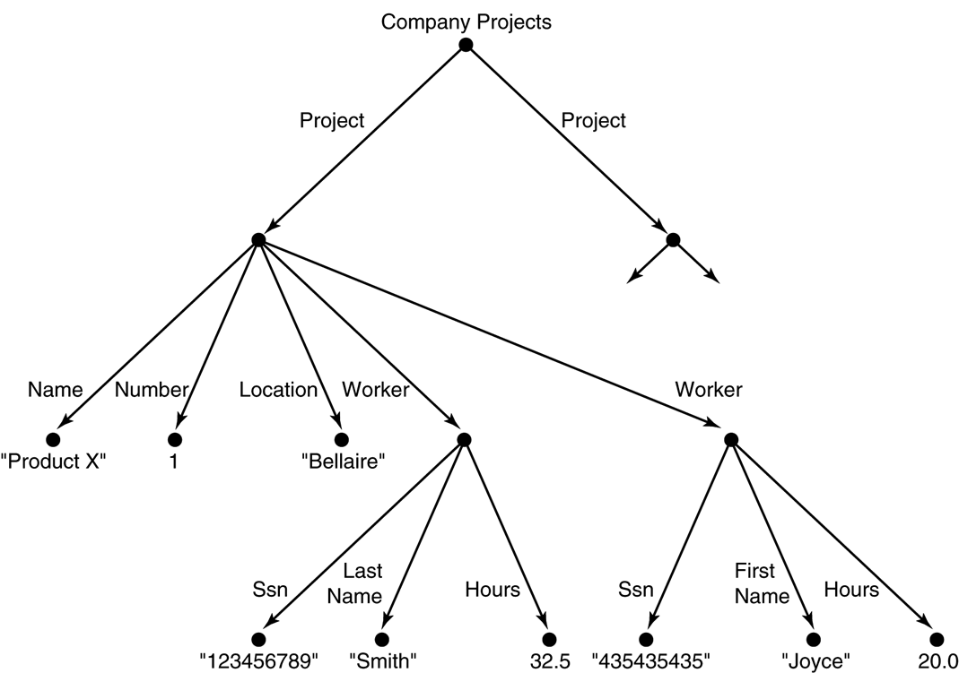
Structured, Semi Structured and Unstructured Data (contd.)
Semi-structured data may be
displayed as a directed graph...
  The labels or tags on the directed edges represent the schema names—the names of attributes, object types (or entity types or classes), and relationships.
  The internal nodes represent individual objects or composite attributes.
  The leaf nodes represent actual data values of simple (atomic) attributes.
Slide 27- <number>

Slide 9
FIGURE 27.1 Representing semistructured data as a graph.
Slide 27- <number>

Slide 10
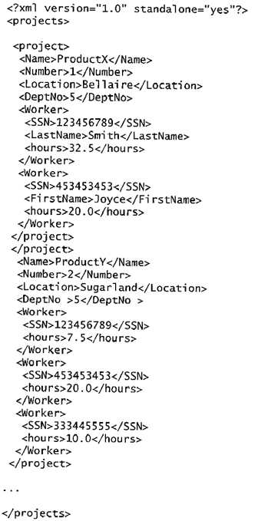
XML Hierarchical (Tree) Data Model
FIGURE 27.3
A complex XML element called <projects>
Slide 27- <number>

Slide 11
XML Hierarchical (Tree) Data Model (contd.)
The basic object is XML is the XML document.
There are two main structuring concepts that are used to construct an XML document:
  Elements
  Attributes
Attributes in XML provide additional information that describe elements.
Slide 27- <number>

Slide 12
XML Hierarchical (Tree) Data Model (contd.)
As in HTML, elements are identified in a document by their start tag and end tag.
  The tag names are enclosed between angled brackets <…>, and end tags are further identified by a backslash </…>.
Complex elements are constructed from other elements hierarchically, whereas simple elements contain data values.
It is straightforward to see the correspondence between the XML textual representation and the tree structure.
  In the tree representation, internal nodes represent complex elements, whereas leaf nodes represent simple elements.
  That is why the XML model is called a tree model or a hierarchical model.
Slide 27- <number>

Slide 13
XML Hierarchical (Tree) Data Model (contd.)
It is possible to characterize three main types of XML documents:
  Data-centric XML documents
    These documents have many small data items that follow a specific structure, and hence may be extracted from a structured database. They are formatted as XML documents in order to exchange them or display them over the Web.
  Document-centric XML documents:
    These are documents with large amounts of text, such as news articles or books. There is little or no structured data elements in these documents.
  Hybrid XML documents:
    These documents may have parts that contains structured data and other parts that are predominantly textual or unstructured.
Slide 27- <number>

Slide 14
XML Documents, DTD, and XML Schema
Two types of XML
  Well-Formed XML
  Valid XML
Slide 27- <number>

Slide 15
XML Documents, DTD, and XML Schema
Well-Formed XML
  It must start with an XML declaration to indicate the version of XML being used—as well as any other relevant attributes.
  It must follow the syntactic guidelines of the tree model.
    This means that there should be a single root element, and every element must include a matching pair of start tag and end tag within the start and end tags of the parent element.
Slide 27- <number>

Slide 16
XML Documents, DTD, and XML Schema
Well-Formed XML (contd.)
  A well-formed XML document is syntactically correct
    This allows it to be processed by generic processors that traverse the document and create an internal tree representation.
      DOM (Document Object Model) - Allows programs to manipulate the resulting tree representation corresponding to a well-formed XML document. The whole document must be parsed beforehand when using dom.
      SAX - Allows processing of XML documents on the fly by notifying the processing program whenever a start or end tag is encountered.
Slide 27- <number>

Slide 17
XML Documents, DTD, and XML Schema
Valid XML
  A stronger criterion is for an XML document to be valid.
  In this case, the document must be well-formed, and in addition the element names used in the start and end tag pairs must follow the structure specified in a separate XML DTD (Document Type Definition) file or XML schema file.
Slide 27- <number>

Slide 18
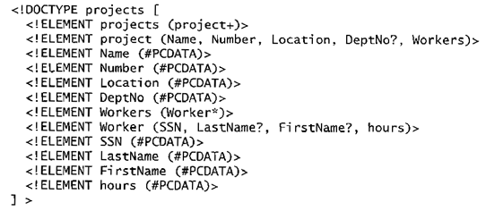
XML Documents, DTD, and XML Schema (contd.)
FIGURE 27.4 An XML DTD file called projects
Slide 27- <number>

Slide 19
XML Documents, DTD, and XML Schema (contd.)
XML DTD Notation
  A * following the element name means that the element can be repeated zero or more times in the document. This can be called an optional multivalued (repeating) element.
  A + following the element name means that the element can be repeated one or more times in the document. This can be called a required multivalued (repeating) element.
  A ? following the element name means that the element can be repeated zero or one times. This can be called an optional single-valued (non-repeating) element.
  An element appearing without any of the preceding three symbols must appear exactly once in the document. This can be called an required single-valued (non-repeating) element.
Slide 27- <number>

Slide 20
XML Documents, DTD, and XML Schema (contd.)
XML DTD Notation (contd.)
  The type of the element is specified via parentheses following the element.
    If the parentheses include names of other elements, these would be the children of the element in the tree structure.
    If the parentheses include the keyword #PCDATA or one of the other data types available in XML DTD, the element is a leaf node. PCDATA stands for parsed character data, which is roughly similar to a string data type.
  Parentheses can be nested when specifying elements.
  A bar symbol ( e1 | e2 ) specifies that either e1 or e2 can appear in the document.
Slide 27- <number>

Slide 21
XML Documents, DTD, and XML Schema (contd.)
Limitations of XML DTD
  First, the data types in DTD are not very general.
  Second, DTD has its own special syntax and so it requires specialized processors.
    It would be advantageous to specify XML schema documents using the syntax rules of XML itself so that the same processors for XML documents can process XML schema descriptions.
  Third, all DTD elements are always forced to follow the specified ordering the document so unordered elements are not permitted.
Slide 27- <number>

Slide 22
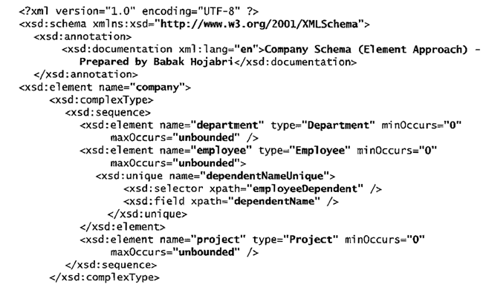
XML Documents, DTD, and XML Schema (contd.)
FIGURE 27.5 An XML schema file called company
Slide 27- <number>

Slide 23
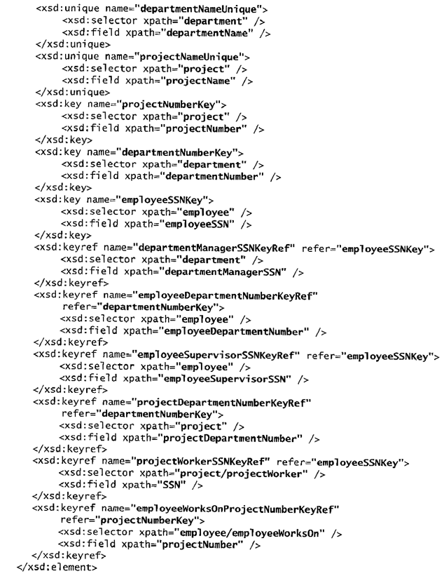
XML Documents, DTD, and XML Schema (contd.)
FIGURE 27.5 An XML schema file called company (contd.)
Slide 27- <number>

Slide 24
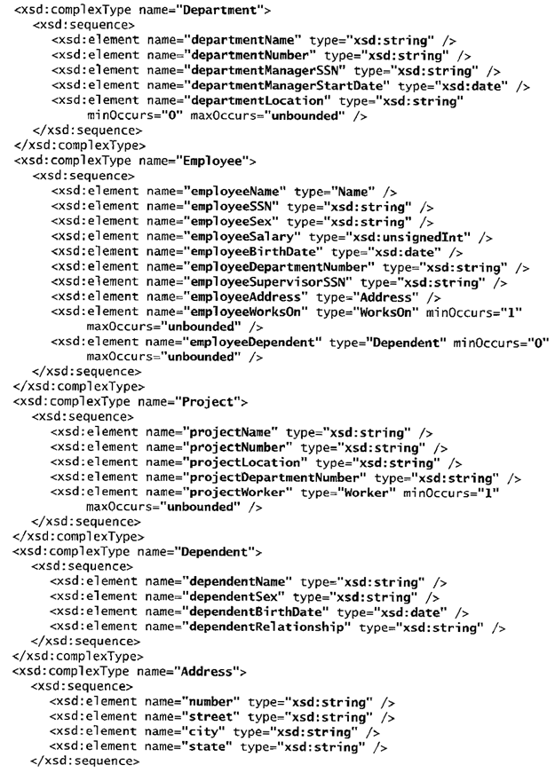
XML Documents, DTD, and XML Schema (contd.)
FIGURE 27.5 An XML schema file called company (contd.)
Slide 27- <number>

Slide 25
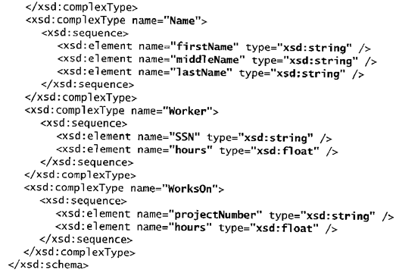
XML Documents, DTD, and XML Schema (contd.)
FIGURE 27.5 An XML schema file called company (contd.)
Slide 27- <number>

Slide 26
XML Documents, DTD, and XML Schema (contd.)
XML Schema
  Schema Descriptions and XML Namespaces
    It is necessary to identify the specific set of XML schema language elements (tags) by a file stored at a Web site location.
      The second line in our example specifies the file used in this example, which is: "http://www.w3.org/2001/XMLSchema".
    Each such definition is called an XML namespace.
    The file name is assigned to the variable xsd using the attribute xmlns (XML namespace), and this variable is used as a prefix to all XML schema tags.
Slide 27- <number>

Slide 27
XML Documents, DTD, and XML Schema (contd.)
FIGURE 27.5 An XML schema file called company
Slide 27- <number>

Slide 28
XML Documents, DTD, and XML Schema (contd.)
XML Schema (contd.)
  Annotations, documentation, and language used:
    The xsd:annotation and xsd:documentation are used for providing comments and other descriptions in the XML document.
    The attribute XML:lang of the xsd:documentation element specifies the language being used. E.g., “en”
Slide 27- <number>

Slide 29
XML Documents, DTD, and XML Schema (contd.)
XML Schema (contd.)
  Elements and types:
    We specify the root element of our XML schema. In XML schema, the name attribute of the xsd:element tag specifies the element name, which is called company for the root element in our example.
    The structure of the company root element is a xsd:complexType.
Slide 27- <number>

Slide 30
XML Documents, DTD, and XML Schema (contd.)
XML Schema (contd.)
  First-level elements in the company database:
    These elements are named employee, department, and project, and each is specified in an xsd:element tag. If a tag has only attributes and no further sub-elements or data within it, it can be ended with the back slash symbol (/>) and termed Empty Element.
Slide 27- <number>

Slide 31
XML Documents, DTD, and XML Schema (contd.)
XML Schema (contd.)
  Specifying element type and minimum and maximum occurrences:
    If we specify a type attribute in an xsd:element, this means that the structure of the element will be described separately, typically using the xsd:complexType element. The minOccurs and maxOccurs tags are used for specifying lower and upper bounds on the number of occurrences of an element. The default is exactly one occurrence.
Slide 27- <number>

Slide 32
XML Documents, DTD, and XML Schema (contd.)
XML Schema (contd.)
  Specifying Keys:
    For specifying primary keys, the tag xsd:key is used.
    For specifying foreign keys, the tag xsd:keyref is used.
      When specifying a foreign key, the attribute refer of the xsd:keyref tag specifies the referenced primary key whereas the tags xsd:selector and xsd:field specify the referencing element type and foreign key.
Slide 27- <number>

Slide 33
XML Documents, DTD, and XML Schema (contd.)
XML Schema (contd.)
  Specifying the structures of complex elements via complex types:
    Complex elements in our example are Department, Employee, Project, and Dependent, which use the tag xsd:complexType. We specify each of these as a sequence of subelements corresponding to the database attributes of each entity type by using the xsd:sequence and xsd:element tags of XML schema. Each element is given a name and type via the attributes name and type of xsd:element.
    We can also specify minOccurs and maxOccurs attributes if we need to change the default of exactly one occurrence. For (optional) database attributes where null is allowed, we need to specify minOccurs = 0, whereas for multivalued database attributes we need to specify maxOccurs = “unbounded” on the corresponding element.
Slide 27- <number>

Slide 34
XML Documents, DTD, and XML Schema (contd.)
XML Schema (contd.)
  Composite (compound) attributes:
    Composite attributes from ER Schema are also specified as complex types in the XML schema, as illustrated by the Address, Name, Worker, and WorksOn complex types. These could have been directly embedded within their parent elements.
Slide 27- <number>

Slide 35
XML Documents and Databases.
Approaches to Storing XML Documents
  Using a DBMS to store the documents as text:
    We can use a relational or object DBMS to store whole XML documents as text fields within the DBMS records or objects. This approach can be used if the DBMS has a special module for document processing, and would work for storing schemaless and document-centric XML documents.
  Using a DBMS to store the document contents as data elements:
    This approach would work for storing a collection of documents that follow a specific XML DTD or XML schema. Since all the documents have the same structure, we can design a relational (or object) database to store the leaf-level data elements within the XML documents.
Slide 27- <number>

Slide 36
XML Documents and Databases.
Approaches to Storing XML Documents (contd.)
  Designing a specialized system for storing native XML data:
    A new type of database system based on the hierarchical (tree) model would be designed and implemented. The system would include specialized indexing and querying techniques, and would work for all types of XML documents.
  Creating or publishing customized XML documents from pre-existing relational databases:
    Because there are enormous amounts of data already stored in relational databases, parts of these data may need to be formatted as documents for exchanging or displaying over the Web.
Slide 27- <number>

Slide 37
XML Documents, DTD, and XML Schema (contd.)
Extracting XML Documents from Relational Databases.
  Suppose that an application needs to extract XML documents for student, course, and grade information from the university database.
  The data needed for these documents is contained in the database attributes of the entity types course, section, and student as shown below (part of the main ER), and the relationships s-s and c-s between them.
Slide 27- <number>

Slide 38
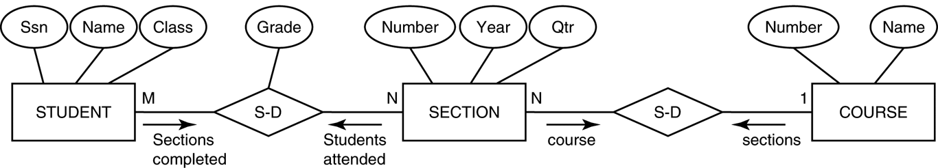
Subset of the UNIVERSITY database schema
FIGURE 27.7
Subset of the UNIVERSITY database schema needed for XML document extraction.
Slide 27- <number>

Slide 39
XML Documents, DTD, and XML Schema (contd.)
Extracting XML Documents from Relational Databases
  One of the possible hierarchies that can be extracted from the database subset could choose COURSE as the root.
Slide 27- <number>

Slide 40
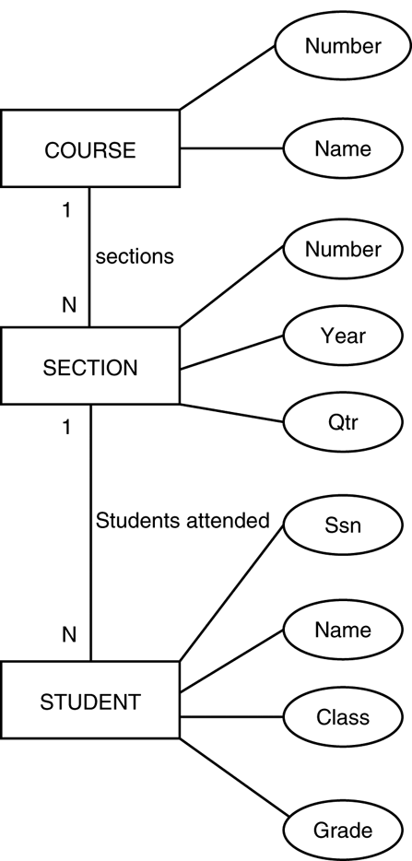
Hierarchical (tree) view with COURSE as the root
FIGURE 27.8
Hierarchical (tree) view with COURSE as the root.
Slide 27- <number>

Slide 41
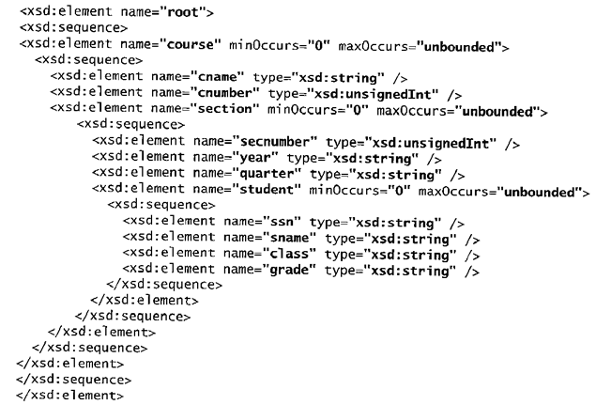
XML schema document with COURSE as the root
FIGURE 27.9
Slide 27- <number>

Slide 42
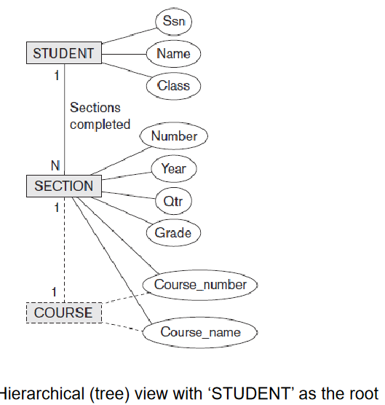
Slide 27- <number>

Slide 43
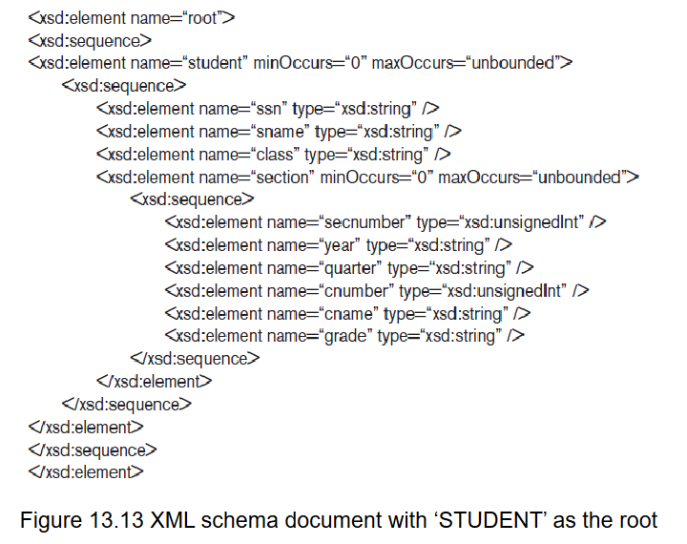
Slide 27- <number>

Slide 44
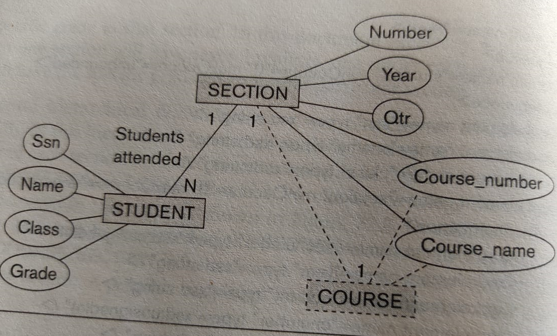
Hierarchical Tree view with the SECTION as the Root
Slide 27- <number>

Slide 45
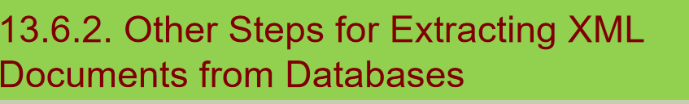
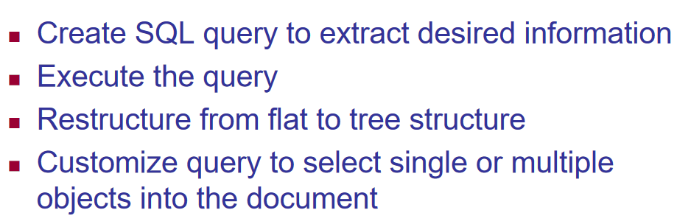
Slide 27- <number>

Slide 46
XML Documents, DTD, and XML Schema (contd.)
Breaking Cycles To Convert Graphs into Trees
  It is possible to have a more complex subset with one or more cycles, indicating multiple relationships among the entities.
  Suppose that we need the information in all the entity types and relationships in figure below for a particular XML document, with student as the root element.
Slide 27- <number>

Slide 47
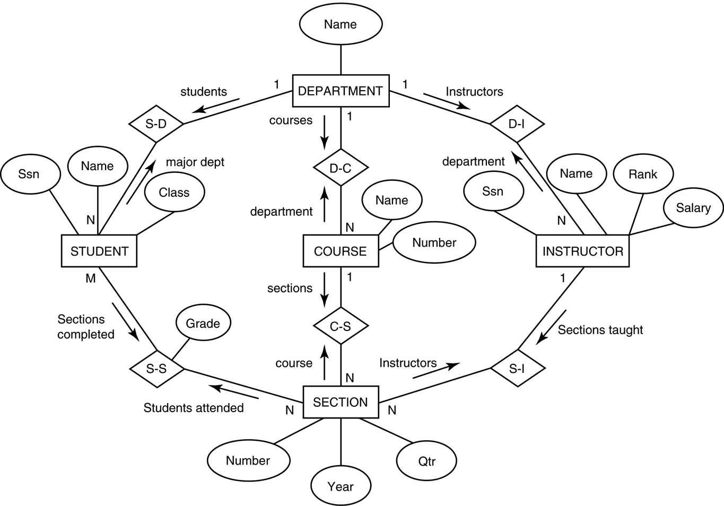
An ER schema diagram for a simplified UNIVERSITY database.
FIGURE 27.6
Slide 27- <number>

Slide 48
XML Documents, DTD, and XML Schema (contd.)
Breaking Cycles To convert Graphs into Trees
  One way to break the cycles is to replicate the entity types involved in cycles.
    First, we replicate INSTRUCTOR as shown in part (2) of Figure, calling the replica to the right INSTRUCTOR1. The INSTRUCTOR replica on the left represents the relationship between instructors and the sections they teach, whereas the INSTRUCTOR1 replica on the right represents the relationship between instructors and the department each works in.
    We still have the cycle involving COURSE, so we can replicate COURSE in a similar manner, leading to the hierarchy shown in part (3) . The COURSE1 replica to the left represents the relationship between courses and their sections, whereas the COURSE replica to the right represents the relationship between courses and the department that offers each course.
Slide 27- <number>

Slide 49
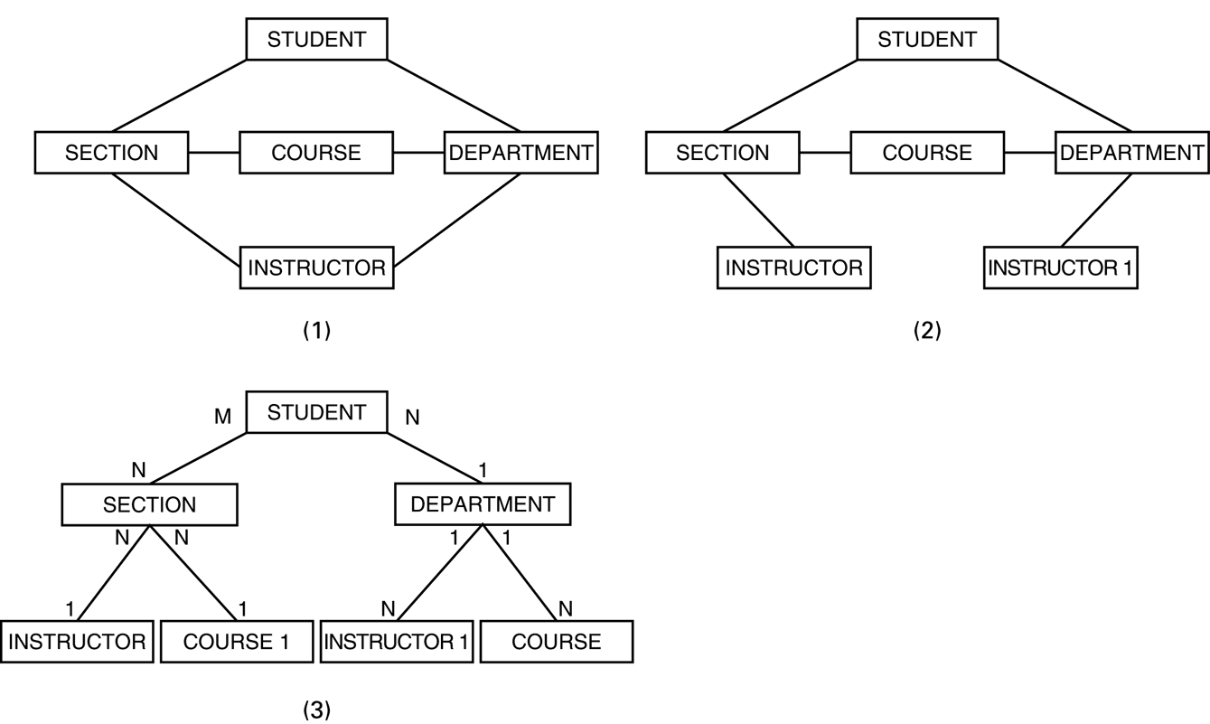
Converting a graph with cycles into a hierarchical (tree) structure
FIGURE 27.13
Slide 27- <number>

Slide 50
XML Querying
XPath
  An XPath expression returns a collection of element nodes that satisfy certain patterns specified in the expression.
  The names in the XPath expression are node names in the XML document tree that are either tag (element) names or attribute names, possibly with additional qualifier conditions to further restrict the nodes that satisfy the pattern.
Slide 27- <number>

Slide 51
XML Querying
XPath (contd.)
  There are two main separators when specifying a path:
    single slash (/) and double slash (//)
      A single slash before a tag specifies that the tag must appear as a direct child of the previous (parent) tag, whereas a double slash specifies that the tag can appear as a descendant of the previous tag at any level.
  It is customary to include the file name in any XPath query allowing us to specify any local file name or path name that specifies the path.
  doc(www.company.com/info.XML)/company => COMPANY XML doc
Slide 27- <number>

Slide 52
XML Querying
Returns the COMPANY root node and all its descendant nodes, which means that it returns the whole XML document.
Returns all department nodes (elements) and their descendant subtrees.
Returns all employeeName nodes that are direct children of an employee node, such that the employee node has another child element employeeSalary whose value is greater than 70000.
This returns the same result as the previous one except that we specified the full path name in this example.
This returns all projectWorker nodes and their descendant nodes that are children under a path /company/project and that have a child node hours with value greater than 20.0 hours.
Slide 27- <number>

Slide 53

Some examples of XPath expressions
FIGURE 27.14
Some examples of XPath expressions on XML documents that follow the XML schema file COMPANY in FIGURE 27.5.
Slide 27- <number>

Slide 54
XML Querying
XQuery
  XQuery uses XPath expressions, but has additional constructs.
  XQuery permits the specification of more general queries on one or more XML documents.
  The typical form of a query in XQuery is known as a FLWR expression, which stands for the four main clauses of XQuery and has the following form:
    FOR <variable bindings to individual nodes (elements)>
    LET <variable bindings to collections of nodes (elements)>
    WHERE <qualifier conditions>
    RETURN <query result specification>
Slide 27- <number>

Slide 55
XML Querying
This query retrieves the first and last names of employees who earn more than 70000. The variable $x is bound to each employeeName element that is a child of an employee element, but only for employee elements that satisfy the qualifier that their employeeSalary is greater that 70000.
This is an alternative way of retrieving the same elements retrieved by the first query.
This query illustrates how a join operation can be performed by having more than one variable. Here, the $x variable is bound to each projectWorker element that is a child of project number 5, whereas the $y variable is bound to each employee element. The join condition matches SSN values in order to retrieve the employee names.
Slide 27- <number>

Slide 56
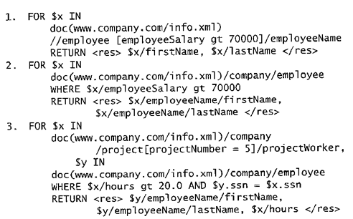
Some Examples of XQuery Queries
Some examples of XQuery queries on XML documents that follow the XML schema file COMPANY in FIGURE 27.5.
Slide 27- <number>

Slide 57
Recap
Introduction
Structured, Semi structured, and Unstructured Data.
XML Hierarchical (Tree) Data Model.
XML Documents, DTD, and XML Schema.
XML Documents and Databases.
XML Querying.
  XPath
  XQuery
Slide 27- <number>

